Slide 1
INSTRUCTIONS
Use Font size 22 to 28 and Font Style Times New Roman (body)
Do not change the Template: Heading / Title of the slides
Do not change font style or colours
Do not copy paste paragraphs: use only Bullet Points
Maximum slide Limit is 20 only
As per the number of supervisor allotted adopt slide-2 or slide-3
Please display the required meaningful Content or images or tables
Change the footer accordingly using insert tab then click on header & footer tab and edit it
Save the PPT with Register No, Dept and Review no, example: 23xxxxxxxxx_CSE

Slide 2

Title: Shop Ease
Student Name: Y.Akshaya
Student ID: 2520030577
Cluster:4
Section: 14
Under the Guidance
of
Supervisor Name:NM Deepika
Assistant Professor
Department of CSE

Slide 3
OUTLINE
Abstract
Existing System
Proposed System
System Architecture
Project Modules
Objectives
Co’s Attainments - FWD
Co1
Co2 …….. 5. Co5
Co’s Attainments - DSA
Co1
Co2 …….. 5. Co5
Screen Shots for FWD & DSA
Conclusion
Geo-Tagged Photos

Slide 4
Abstract
ShopEasy is a web-based E-Commerce platform that allows users to browse and purchase products online.
The main objective of the system is to provide a simple, fast, and convenient online shopping experience for customers.
Users must first log in and create a profile with valid personal details before accessing the website.
The platform displays a wide range of products with images, names, and prices for easy browsing.
Customers can search for products using the search bar to quickly find items.
The system allows users to add products to a shopping cart and manage quantities.
Users can remove items from the cart and view the total price of selected products.
The website includes a checkout system where customers enter delivery details and select a payment method.

Slide 5
Existing System
In the existing system, customers often purchase products from different individual e-commerce websites.
Each website has its own separate platform and product listings.
Users need to visit multiple websites to compare products and prices.
The shopping process becomes time-consuming for customers.
Many platforms require separate accounts or logins for each website.
The cart system is limited to a single website, so products from other sites cannot be added to the same cart.
Customers must place separate orders on different platforms.

Slide 6
Proposed System
The proposed system is a web-based E-Commerce platform called ShopEasy.
It provides a single platform where users can browse and purchase various products online.
Users must log in and create a profile before accessing the shopping features.
The system displays multiple products with images, names, and prices for easy selection.
Customers can search for products using the search bar to quickly find items.
The platform allows users to add products to a shopping cart.
Users can update product quantities or remove items from the cart.
The system automatically calculates the total price of the products in the cart.

Slide 7
System Architecture
In this project, data is temporarily stored using JavaScript arrays.
System Flow
User opens the website in a browser.
User logs in and creates a profile.
The system displays available products.
User searches and adds products to the cart.
The cart calculates the total price.
User enters delivery details and selects a payment method.
The system generates an order ID and confirms the order.

Slide 8
Project Modules
Profile Management Module
Users must create a profile after login.
Collects details such as Full Name, Email, and Mobile Number.
Performs validation checks (gmail email format and 10-digit phone number).
Stores user information for displaying in the website.
Product Display Module
Displays a list of available products with images and prices.
Products are shown in card format for easy viewing.
Allows users to browse different products easily.

Slide 9
Objectives
To develop a web-based e-commerce platform for online product shopping.
To provide a simple and user-friendly interface for customers.
To allow users to log in and create a personal profile before shopping.
To display different products with images, names, and prices for easy browsing.
To enable users to search products quickly using a search feature.
To allow customers to add products to a shopping cart.
To provide options to update quantity or remove items from the cart.
To automatically calculate the total price of items in the cart.

Slide 10
Co’s Attainments - FWD
CO1 – Internet Fundamentals, HTML & Introductory CSS Styling
Attainment in Shop Ease Project
Understanding of internet fundamentals and web architecture while developing a web-based shopping platform.
Implementation of HTML document structure to organize webpages such as Home, Products, and Cart pages.
CO2 – HTML Forms, Semantic Tags & Comprehensive CSS Layouts
Attainment in Shop Ease Project
Implementation of HTML forms for user login, registration, and order placement.
Use of different input types and validation attributes to ensure correct user input.
Application of semantic HTML tags for better structure and accessibility.

Slide 11
Co’s Attainments - FWD
CO3 – JavaScript Programming Essentials
Attainment in Shop Ease Project
Use of JavaScript operators, conditions, and loops to control program flow.
Implementation of functions and arrow functions for reusable code.
Handling arrays and objects to store product information and user selections.
Use of array methods to manage product lists and cart items.
CO4 – JavaScript Interactivity & DOM Manipulation
Attainment in Shop Ease Project

Slide 12
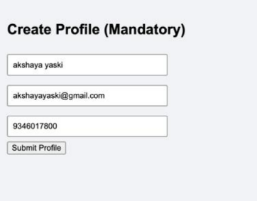
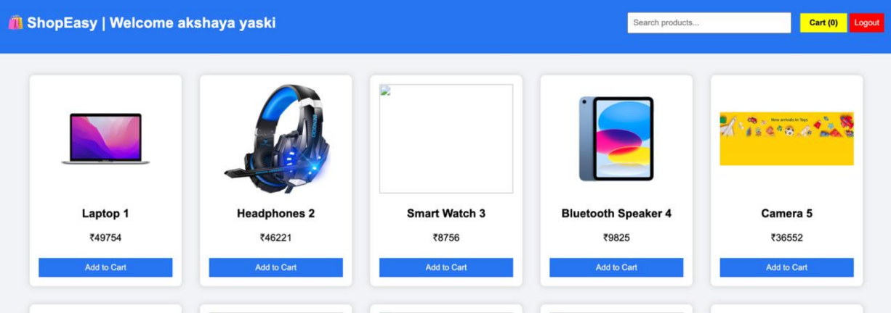
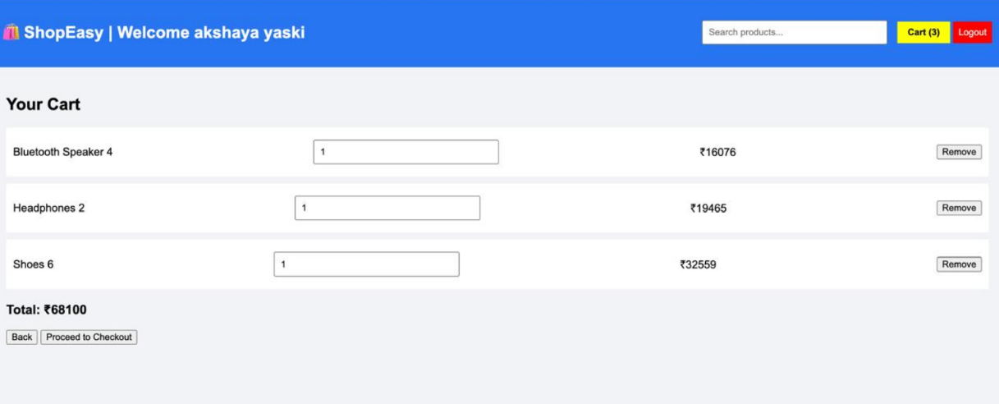
Screenshots for FWD & DSA

Slide 13
Conclusion
Shop Ease provides a simple and efficient online shopping platform for users to browse and purchase products easily.
The project demonstrates the use of HTML, CSS, and JavaScript to develop an interactive and responsive web application.
It allows users to view products, add items to the cart, and manage their shopping selections smoothly.
The system improves user convenience and accessibility compared to traditional shopping methods.
Responsive design and styling techniques ensure the website works well on different devices.
JavaScript and DOM manipulation enhance dynamic user interaction and real-time updates.
Overall, Shop Ease simplifies the online purchasing process and provides a better digital shopping experience.

Slide 14
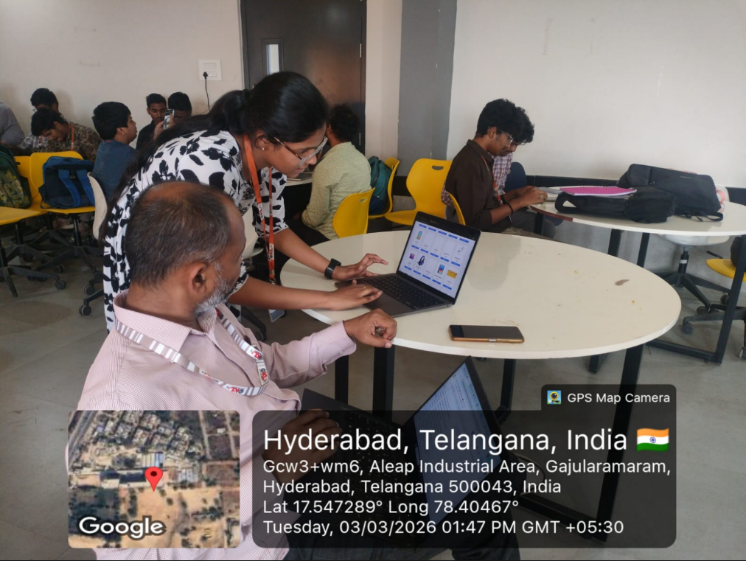

GEO-TAG PHOTOS

Slide 15
THANK YOU

